Slide 1


PROJECT
PORTFOLIO
YASHI GUPTA-DATA ANALYTICS INTERN
2025

Slide 2

PROFESSIONAL BACKGROUND
I am a highly motivated and detail-oriented Data Analyst and Backend Developer with a strong foundation in data analytics, backend development, and automation. Currently pursuing a Bachelor of Computer Science at MGM University, Aurangabad, I have developed a deep interest in analyzing complex datasets, deriving meaningful insights, and optimizing business processes using data-driven approaches. My academic journey has equipped me with expertise in SQL, Python, R, Microsoft Excel, and various database management systems, allowing me to work efficiently in data manipulation, visualization, and statistical analysis.
Professionally, I am working as an Academic Intern at Sort Solution, Nagpur, where I contribute to data-related tasks, research, API development, and documentation. This role has strengthened my ability to handle backend operations and implement effective database solutions. My experience also extends to working on real-world projects involving data cleaning, trend analysis, forecasting, and risk assessment in domains such as finance, marketing, operations, and human resources.
Throughout my academic and professional experiences, I have successfully led multiple data analytics projects, including loan default prediction, hiring data analysis, IMDB movie rating analysis, and call volume trend analysis, demonstrating my ability to translate raw data into actionable business insights. Additionally, my AI-powered Document Management System project showcases my proficiency in FastAPI, Python automation, and cloud-based storage solutions, reinforcing my technical versatility.
Beyond technical expertise, I possess strong problem-solving, adaptability, and communication skills, which enable me to collaborate effectively in team environments. I am passionate about leveraging data science and backend technologies to solve real-world problems, drive efficiency, and contribute to data-driven decision-making. My goal is to continuously explore innovative solutions that bridge the gap between business and technology, making data more accessible, secure, and impactful.

Slide 3
01
DATA ANALYTICS PROCESS
04
02
INSTAGRAM USER ANALYTICS
07
TABLE OF CONTENTS
03
OPERATION & METRIC ANALYTICS
10
04
HIRING PROCESS ANALYTICS
13
05
IMDB MOVIE ANALYSIS
19
06
BANK LOAN CASE STUDY
26
07
IMPACT OF CAR FEATURES
36
08
ABC CALL VOLUME TREND
29

Slide 4
09
LEARNINGS
44
10
LINKS
45
TABLE OF CONTENTS

Slide 5
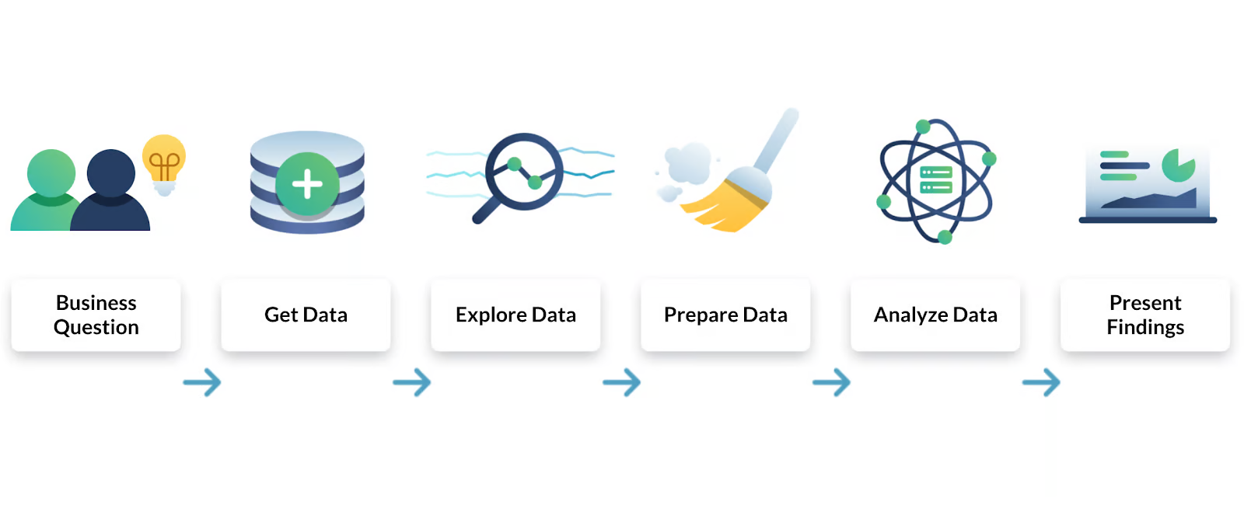
DATA ANALYTICS PROCESS
CHRISTMAS PARTY PLANNING
This project applies data-driven decision-making to a real-world scenario—planning a Christmas party. The project breaks down the Data Analytics Lifecycle into six key phases:
Plan, Prepare, Process, Analyze, Share, and Act.
Decisions such as venue selection, budget allocation, food preferences, and guest engagement were optimized using polls, comparative analysis, and strategic budgeting. The process demonstrated how data analytics plays a role in daily life, influencing structured decision-making and problem-solving.

Slide 6
Plan:
Defined the party's purpose and audience (family, friends, colleagues).
Chose between indoor vs. outdoor and themed vs. non-themed options.
Created a guest list to estimate attendance.
Prepare:
Collected data through polls for food preferences, activities, and budget allocation.
Categorized expenses for food, decorations, and entertainment.
Process:
Finalized the menu and activities based on survey results.
Implemented cost-cutting strategies (DIY decorations, optimized purchases).
Analyze:
Compared venue, catering, and entertainment costs to stay within budget.
Identified areas for optimization to reduce unnecessary expenses.
Share:
Sent invitations and activity schedules to guests.
Followed up on RSVPs and adjusted seating arrangements.
Act:
Purchased necessary supplies and set up the venue.
Hosted the event, making real-time adjustments as needed.

Slide 7
Key Takeaways:
Demonstrated how structured decision-making leads to better event planning.
Utilized data-driven insights (polls, budgeting, comparisons) to optimize costs and guest experience.
Reinforced the idea that data analytics is not limited to business or technology but is applicable in everyday life.

Slide 8
INSTAGRAM USER ANALYTICS
SQL-based Data Analysis
Social media platforms rely heavily on user engagement metrics to enhance their features and advertising strategies. This project analyzed Instagram user behavior to determine engagement trends, most active users, content popularity, and suspicious accounts.
Social media platforms rely heavily on user engagement metrics to enhance their features and advertising strategies. This project analyzed Instagram user behavior to determine engagement trends, most active users, content popularity, and suspicious accounts.
Objective:
Analyze daily, weekly, and monthly activity trends of Instagram users.
Identify top-performing posts and hashtags based on user interactions.
Detect and flag suspicious accounts or bot activity.

Slide 9
Approach:
Data Exploration:
Extracted data from Instagram’s database, focusing on tables such as users, photos, comments, likes, follows, and tags.
Identified primary keys, foreign keys, and composite keys to ensure efficient querying.
SQL Query Execution:
Aggregated user activity to classify users into active and inactive categories.
Used JOIN operations to match posts with their engagement metrics.
Applied COUNT and GROUP BY queries to track the most frequently used hashtags.
Created filters to detect bots that like every post on the platform.

Slide 10
Key Takeaways:
Active vs. Inactive Users: Identified users who frequently engage on the platform and those who never post or interact.
Trending Hashtags: Determined which hashtags received the highest engagement, helping marketers optimize campaigns.
Suspicious Activity: Detected bots that interact excessively with every post, which can lead to spam-related issues.

Slide 11
OPERATION & METRIC ANALYTICS
SQL-based Operational Insights
This project explored user engagement fluctuations and investigated sudden changes in business metrics. The goal was to analyze trends in customer sign-ups, weekly retention, sales spikes, and unusual drops in engagement using SQL-based data analytics.
Objective:
Measure monthly and weekly user growth based on engagement trends.
Investigate sudden metric spikes (e.g., unusual increases in sign-ups, product sales).
Detect user retention patterns using SQL-based data segmentation.

Slide 12
Approach:
Identified Key Metrics:
Analyzed customer acquisition rates, focusing on weekly vs. monthly trends.
Examined user behavior post sign-up to track engagement drop-off points.
Studied the effectiveness of email marketing in driving product adoption.
Data Processing & Query Execution:
Used SQL Joins and UNION operators to combine multiple datasets for trend analysis.
Applied aggregation functions (SUM, COUNT, GROUP BY) to generate insights.
Created rolling averages to smoothen fluctuations and detect actual growth trends.

Slide 13
Key Takeaways:
User retention rates decreased sharply after Week 2, indicating engagement issues.
Identified specific days when engagement spiked, which correlated with marketing campaigns.
Sales surges were linked to promotional emails, confirming their effectiveness in customer acquisition.

Slide 14
HIRING DATA ANALYSIS
Excel-based HR Analytics
This project focused on analyzing hiring trends and salary distributions in a multinational company. The goal was to understand gender representation, salary differences across departments, and hiring patterns.
Objective:
Examine hiring trends, department-wise salary differences, and gender diversity.
Identify departments with the highest workforce allocation.
Evaluate potential biases in hiring and salary distribution.

Slide 15
Approach:
Data Cleaning:
Removed blank records and inconsistencies in the dataset.
Filtered outliers in salary figures to ensure accuracy
Analysis & Insights Generation:
Used Pivot Tables to categorize hires by department and gender.
Performed statistical analysis to compare salaries across different teams.
Identified the highest-paid roles and departments based on historical data.

Slide 16
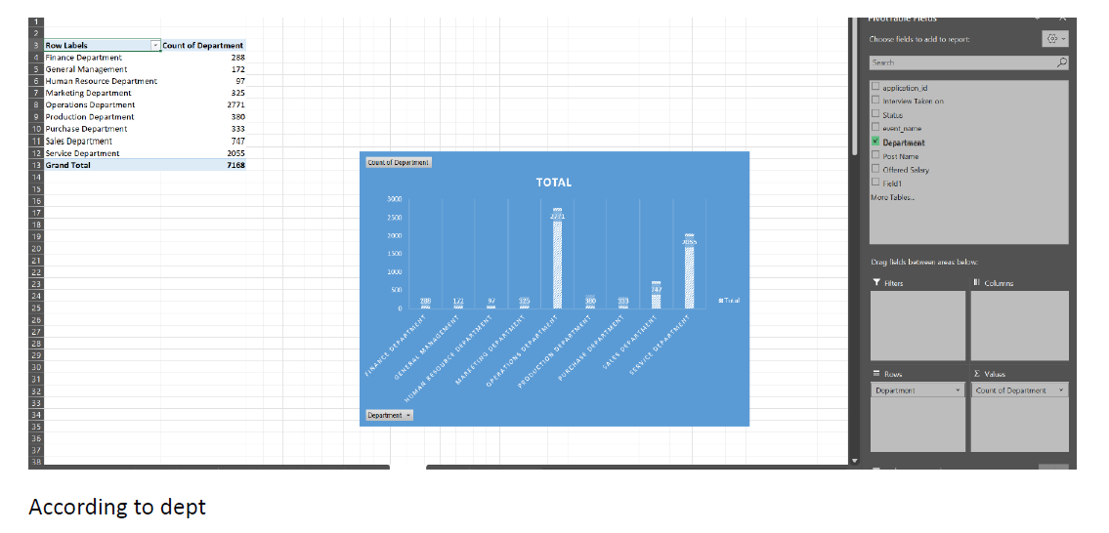
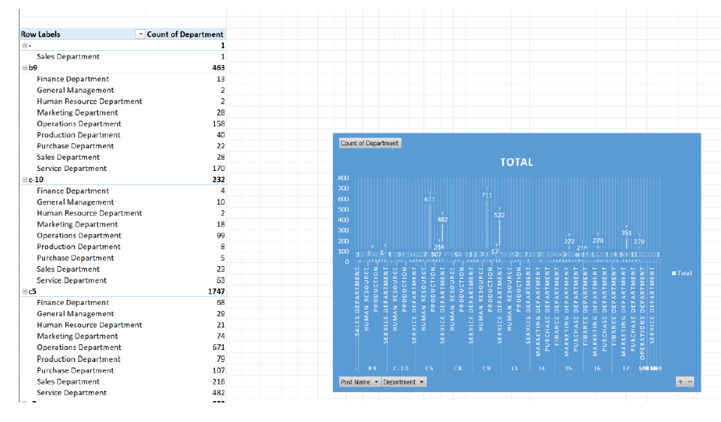
Count of employees

Slide 17
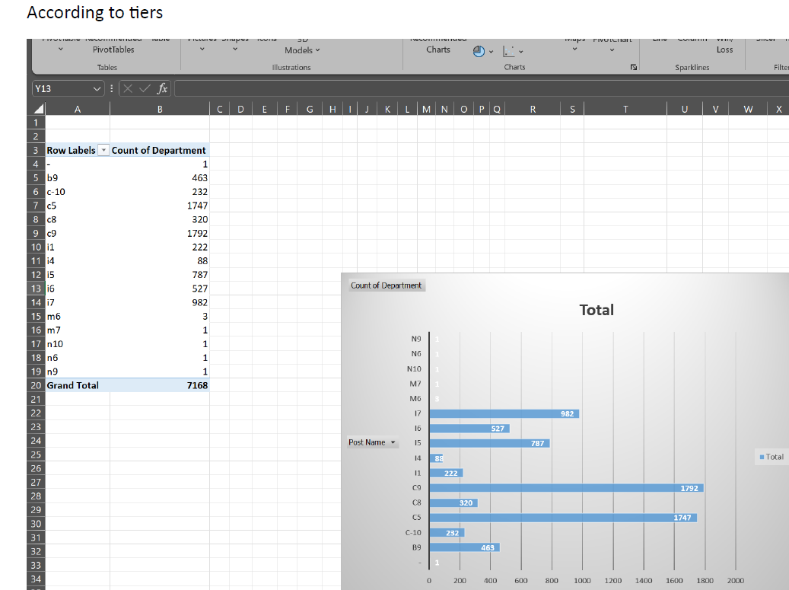
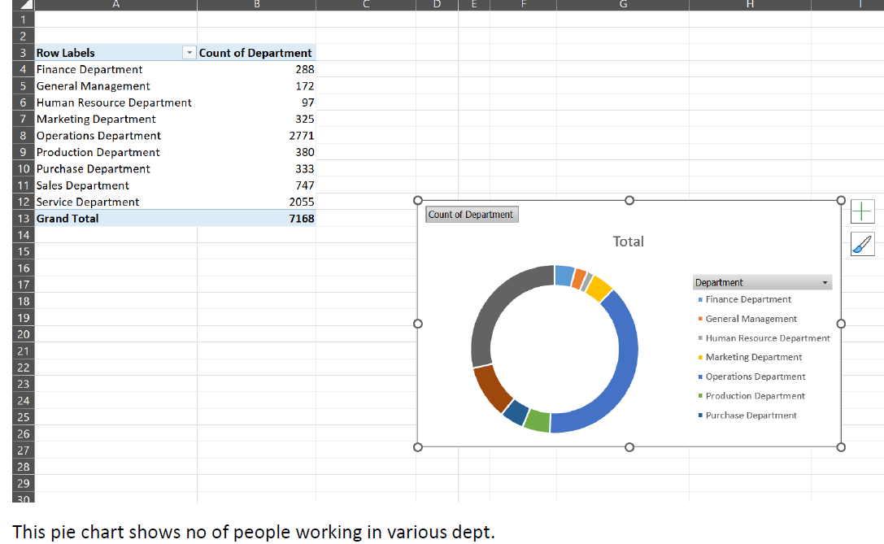

Slide 18
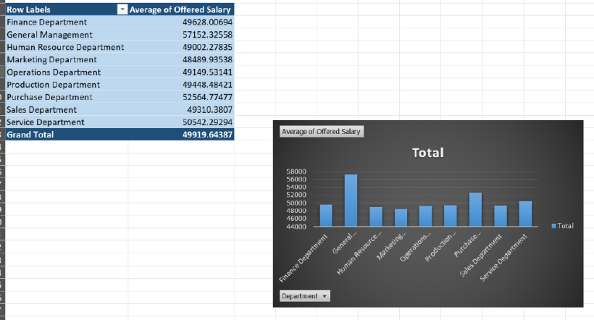
Avg salary w.r.t to dept

Slide 19
Key Insights:
60% of hires were male, indicating a gender gap in recruitment.
Operations & Service departments had the largest workforce, making up the majority of employees.
General Management had the highest average salary, reflecting its strategic importance.

Slide 20
IMDB Movie Analysis
Excel-based Movie Data Analysis
This project focused on analyzing IMDB movie ratings to determine the factors influencing a film's success. Using a structured dataset, various attributes like genre, duration, language, director, and budget were examined to identify their impact on ratings. The insights derived help filmmakers, producers, and investors make data-driven decisions when planning future productions.
Objective:
Determine the most popular movie genres and their correlation with high ratings.
Analyze how movie duration affects viewer reception.
Evaluate the influence of directors and budgets on a film’s performance.

Slide 21
Approach:
Data Cleaning & Preprocessing:
Removed missing or inconsistent values.
Standardized numerical and categorical fields for analysis.
Statistical & Visual Analysis:
Used descriptive statistics (COUNTIF, AVERAGE, PERCENTILE).
Created scatter plots and correlation matrices to detect patterns.

Slide 22
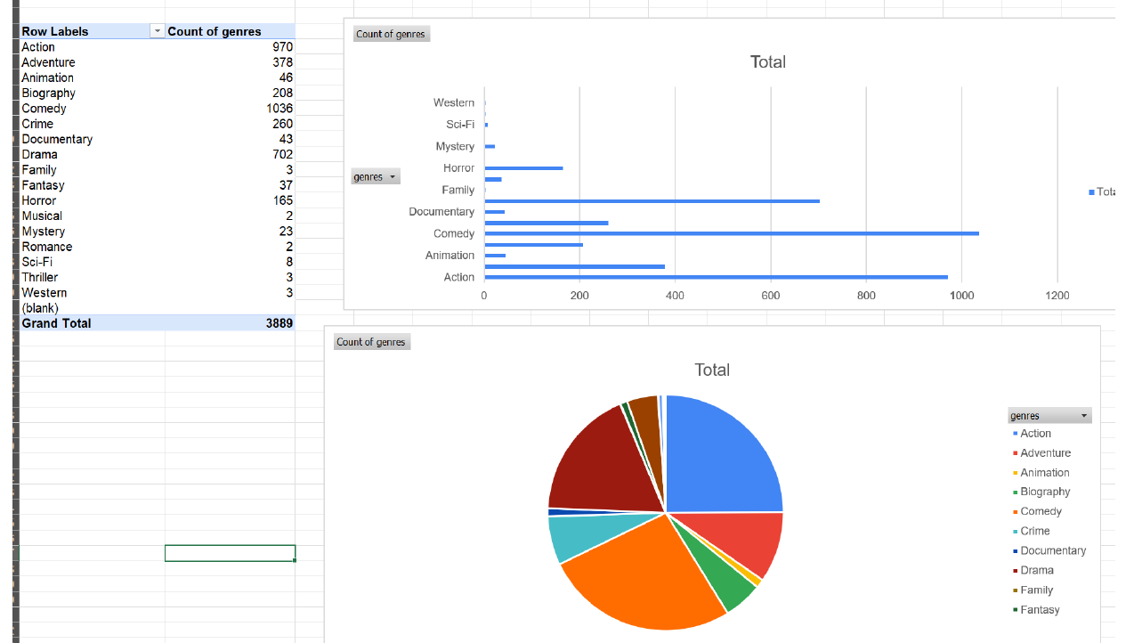
Count of movies in each genre

Slide 23
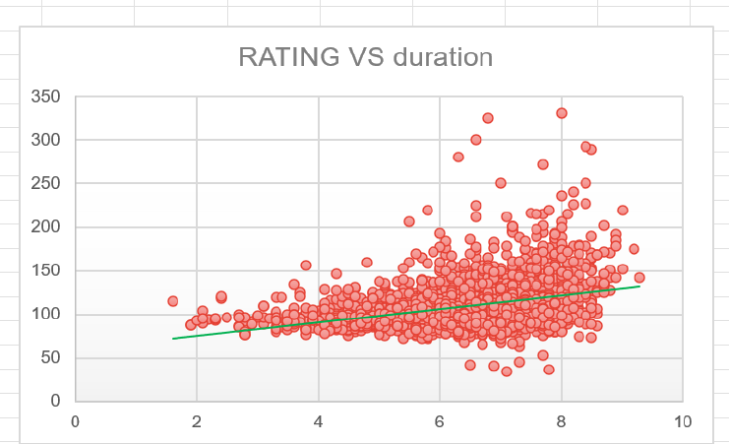
The trendline indicates a slight positive correlation between movie
duration and IMDB score.

Slide 24
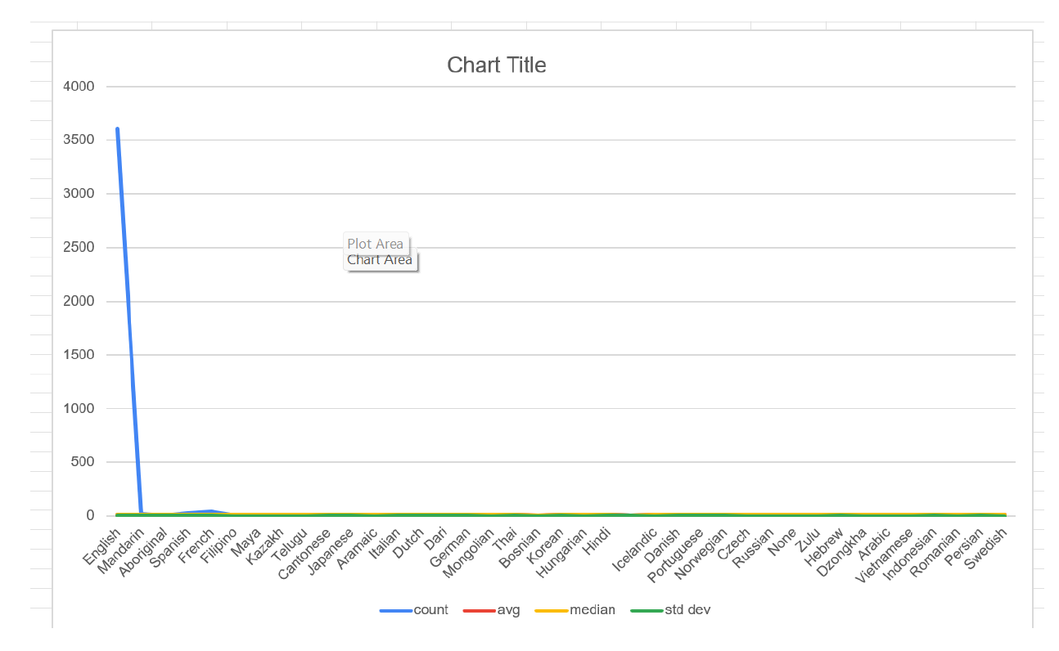
English leads in volume, but smaller languages like Persian and
Telugu excel in quality.

Slide 25
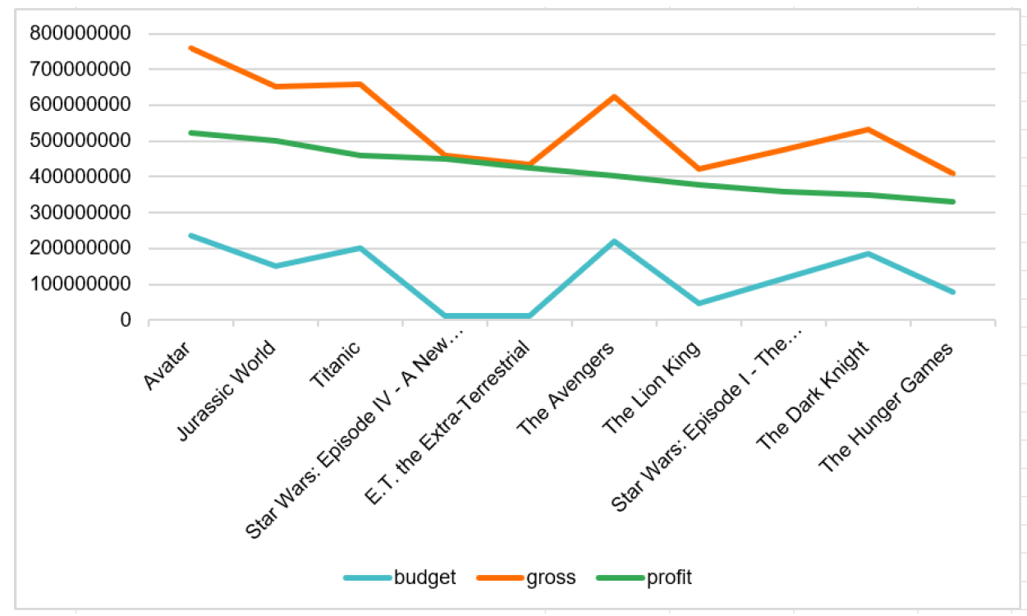
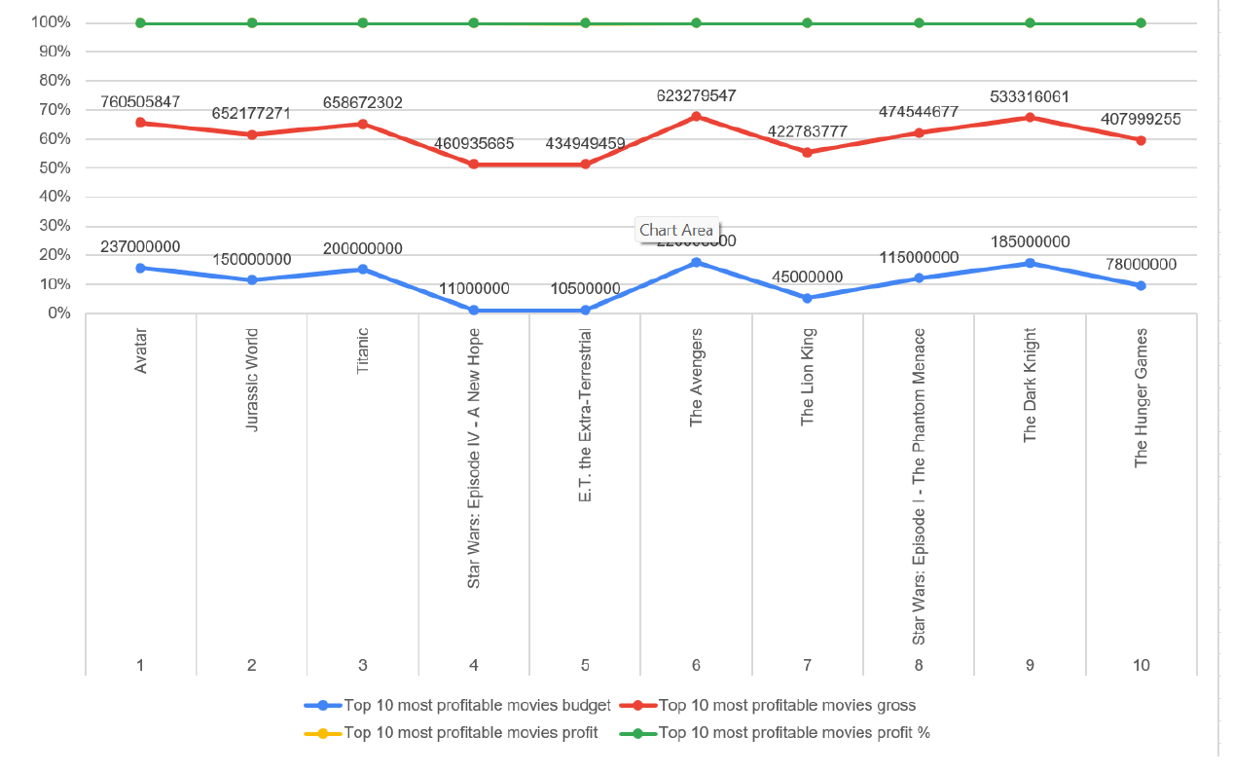
PROFITS AND BUDGETS

Slide 26
Key Insights:
Genres like Action, Comedy, and Drama have consistently higher ratings.
Movie duration does not have a strong correlation with ratings; both short and long films perform well.
Renowned directors tend to receive higher average ratings, proving the importance of industry reputation.
Higher budgets often lead to better-rated movies, but independent films can also achieve high scores with strong storytelling.

Slide 27
Bank Loan Case Study
Exploratory Data Analysis on Loan Approval & Defaults
This project aimed to analyze loan application data to identify key factors contributing to loan defaults. The goal was to help financial institutions refine their loan approval criteria and minimize financial risks. By studying customer demographics, loan types, and repayment patterns, the analysis provided actionable insights for risk assessment and decision-making.
Objective:
Identify high-risk vs. low-risk borrowers based on past repayment behavior.
Examine how age, income, employment type, and loan amount affect default rates.
Provide recommendations for optimizing loan approval strategies.

Slide 28
Approach:
Data Cleaning & Preparation:
Handled missing values and outliers in customer financial records.
Standardized categorical and numerical loan data.
Exploratory Data Analysis (EDA):
Segmented customers based on repayment history.
Used pivot tables, heatmaps, and statistical functions to detect trends.
Compared loan approval rates across different customer profiles.

Slide 29
Key Insights:
Older, educated customers had lower default rates, making them safer borrowers.
Young, low-income individuals had a higher likelihood of default, requiring stricter screening.
Cash loans and high-value loans had a greater risk of non-repayment, highlighting the need for enhanced background checks.
Proposed a risk-based lending strategy to balance loan approvals and minimize defaults.

Slide 30
IMPACT OF CAR FEATURES
Regression & Market Segmentation
This project analyzed how various car features impact pricing and profitability in the automotive industry. By leveraging data analytics, the study helped manufacturers optimize pricing strategies and product development decisions based on consumer demand and feature preferences.
Objective:
Determine which car features (e.g., engine power, fuel efficiency, size) influence price.
Analyze the relationship between market category, brand, and MSRP (Manufacturer's Suggested Retail Price).
Identify key trends in car popularity and their impact on profitability.

Slide 31
Approach:
Data Cleaning & Preprocessing:
Handled missing values, removed duplicates, and standardized feature categories.
Performed feature engineering to create meaningful variables for analysis.
Statistical & Visual Analysis:
Used regression models to determine pricing predictors.
Created pivot tables, scatter plots, and trendline analyses for key insights.
Analyzed market segmentation to compare economy vs. luxury cars.

Slide 32
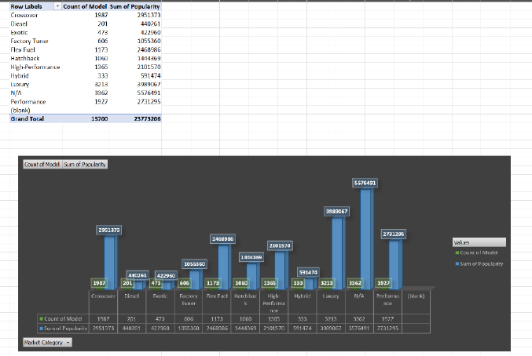
MODEL VS POPULARITY

Slide 33
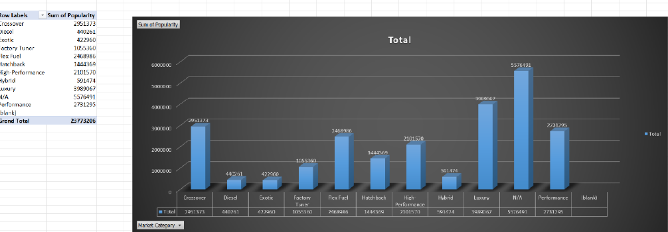
POPULARITY OF MODELS

Slide 34
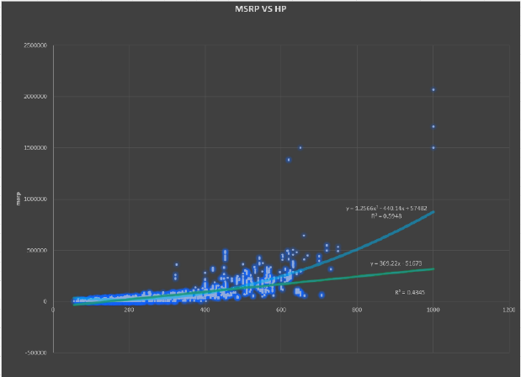
Relationship Between Engine Power and Price

Slide 35
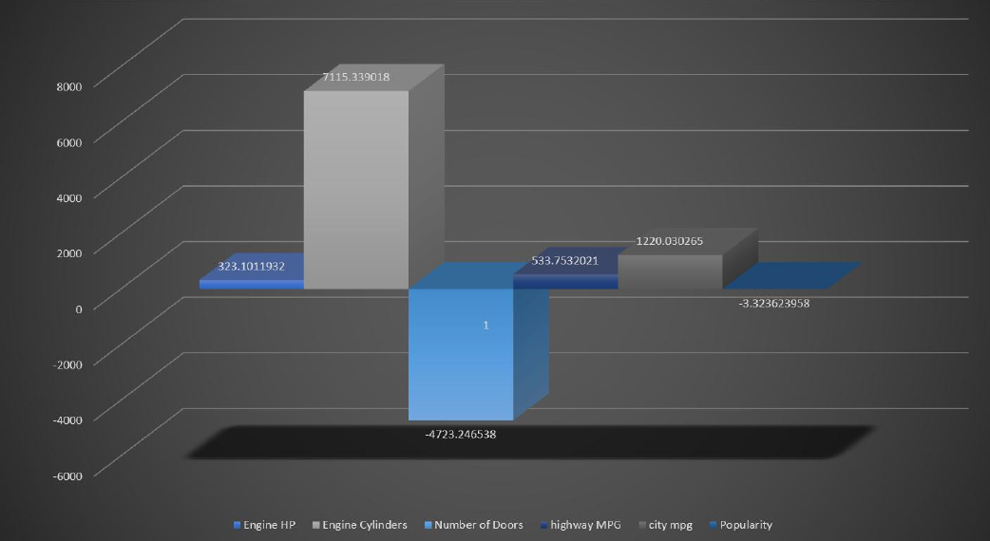
Impact of car features

Slide 36
Key Insights:
Engine horsepower is the strongest predictor of price—higher power leads to higher MSRPs.
Luxury brands (BMW, Mercedes, Audi) consistently have the highest prices, while economy brands (Toyota, Honda) dominate mid-range segments.
Fuel efficiency negatively correlates with price—higher fuel economy is typically seen in more affordable cars.
Market demand for SUVs and crossovers is rising, making them more profitable than sedans in certain categories.

Slide 37
ABC CALL VOLUME TREND
Call Center Optimization Study
This project focused on analyzing inbound call volume trends at ABC Insurance Company to optimize manpower allocation and improve customer service. By studying call patterns over 23 days, the analysis aimed to ensure efficient staffing, reduce wait times, and maintain service quality.
Objective:
Identify peak and low call hours to adjust agent schedules.
Calculate agent handling capacity based on call duration and workload.
Propose a staffing plan for both day and night shifts to improve response rates.

Slide 38
Approach:
Data Exploration & Cleaning:
Analyzed call records to filter missing or inconsistent data.
Segmented calls based on answered, abandoned, and transferred status.
Call Volume & Duration Analysis:
Identified peak call hours (11 AM - 12 PM, 8 AM - 9 AM for night shift).
Calculated average call duration (199 sec) to determine agent workload.
Manpower Planning & Optimization:
Estimated the required number of agents per hour to maintain a 90% call answer rate.
Recommended hiring 257 additional agents to improve service efficiency.

Slide 39
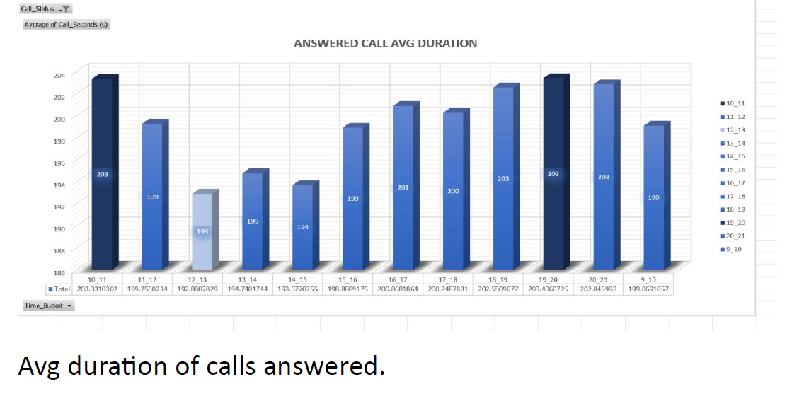
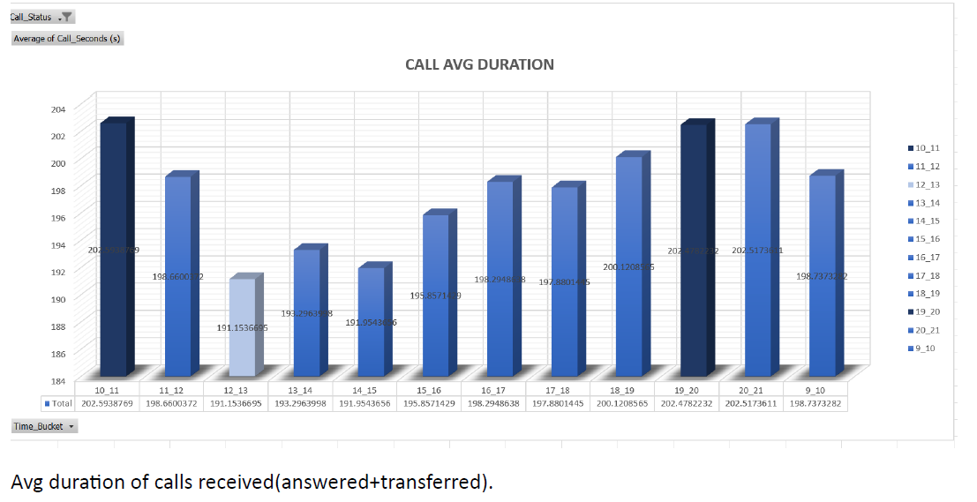

Slide 40
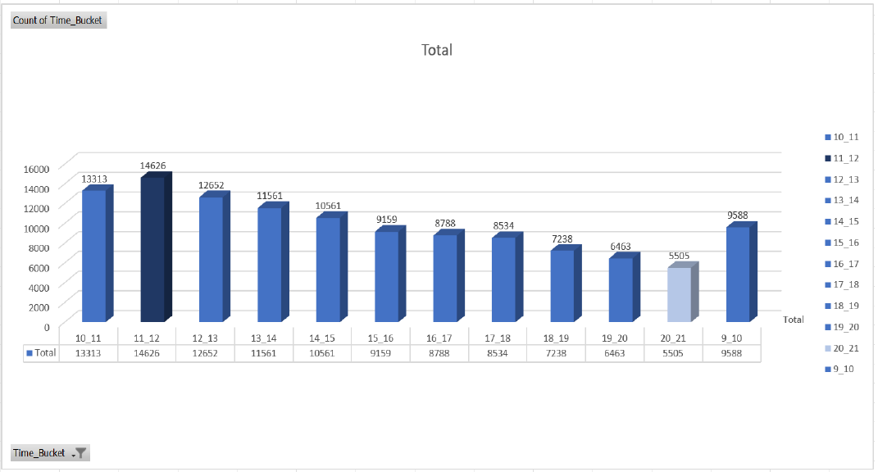
Total no of calls in each time bucket

Slide 41
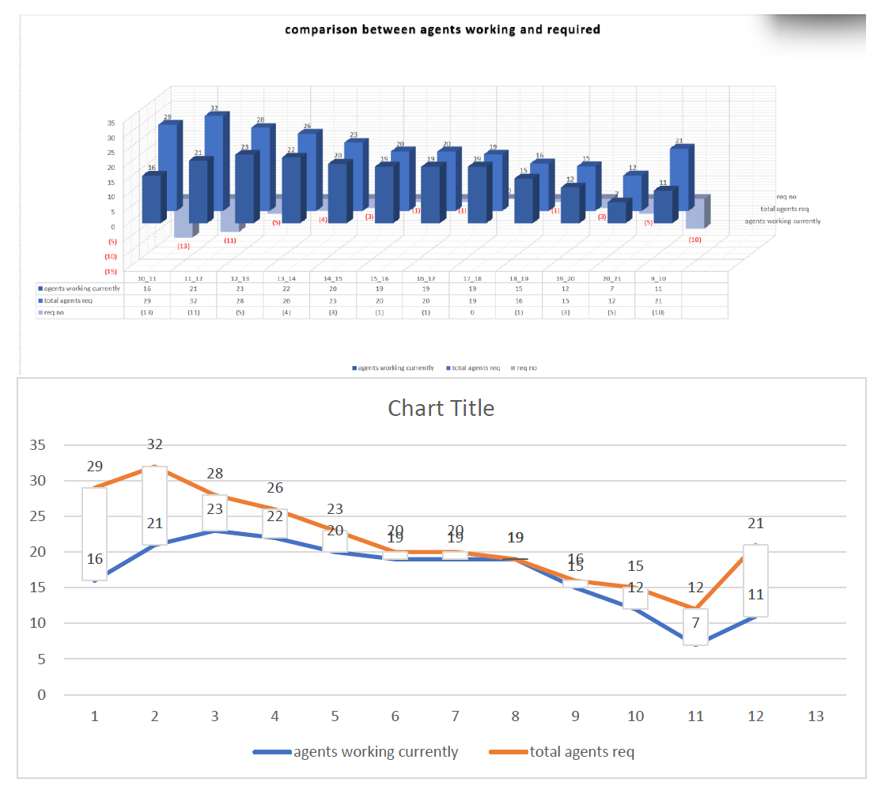

Slide 42
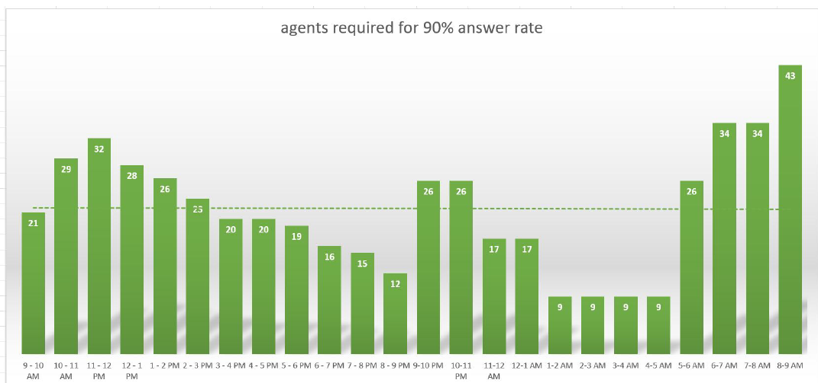
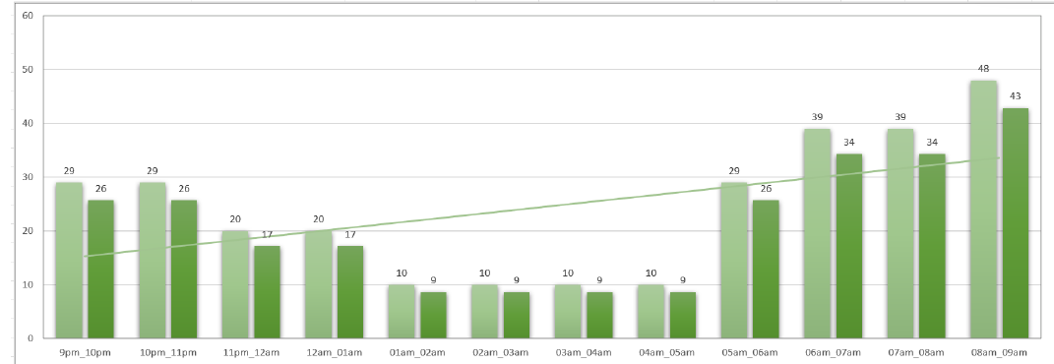
Agents working currently and agents required

Slide 43
Key Insights:
The busiest call period was 11 AM - 12 PM, requiring maximum agent availability.
Night shift calls (9 PM - 9 AM) were not well-staffed, leading to high abandonment rates.
Manpower shortages caused delays in response times, necessitating hiring and schedule adjustments.
Proposed an optimized agent distribution plan to ensure better coverage during peak hours.

Slide 44
LEARNINGS
I have gained a strong foundation in data analytics, problem-solving, and decision-making across various domains like finance, marketing, and operations.
Key Learnings:
Data-Driven Decision Making: Applied structured analytics to optimize hiring, loan approvals, and event planning.
SQL & Data Analysis: Extracted insights using queries, aggregation, and trend analysis.
Statistical & Predictive Modeling: Used regression, correlation, and forecasting for business insights.
Business Optimization: Identified cost-cutting strategies and improved marketing engagement.
Problem Solving & Critical Thinking: Transformed raw data into actionable insights.
Effective Communication: Created structured reports and visual presentations for stakeholders.
Final Reflection:
These projects have enhanced my ability to analyze data, extract insights, and make informed decisions. Moving forward, I aim to expand my expertise in advanced analytics and real-world problem-solving.

Slide 45
REPORT LINKS
Data Analytics Process
https://docs.google.com/presentation/d/1QZs3juDTU3rcP0bkwfHA5A7UklQp_BYE/edit?usp=drive_link&ouid=108286913145936487778&rtpof=true&sd=true
Instagram User Analytics
https://drive.google.com/file/d/1jsNPu9LoaZcQqLPx2FOaQyOt9_fY2XkQ/view?usp=drive_link
Operation & Metric Analytics
https://drive.google.com/file/d/1z3k5jhjsS2sswyAqQgp9i39cfQbvQpZW/view?usp=drive_link
Hiring Process Analytics
https://drive.google.com/file/d/1-NeWhNGbtD5HJzlgE8wJ9U2E8frjCOnv/view?usp=drive_link
IMDB Movie Analysis
https://drive.google.com/file/d/1RuUqDIUNhPpKjKDkRnVt04a9cmJUwWzM/view?usp=drive_link
Bank Loan Case Study
https://drive.google.com/file/d/1lKNamk-Vsuk-Cw09ay_08E7EBcGJkq4M/view?usp=drive_link
Impact of Car Features
https://drive.google.com/file/d/1k-0jpzdR2IvkvciNG0Gy_KBU-L93SYuV/view?usp=drive_link
ABC Call Volume Trend
https://drive.google.com/file/d/1-W4QyoPxfOQsnuD1aqptqeh-vxkuh6SE/view?usp=drive_link

Slide 46
For more information
Contact-
gupta1803yashi@gmail.com
2025

